Slide 1
Customer Sales Analysis
Power BI Internship Project
Submitted by: Rigzen Angmo
Team Id: PTID-CDA-SEP-26-11200-A – CDA
Project Id: PRDA-05: Customer Data Analysis

Slide 2
Project Overview
Analyzed Customer purchasing and sales data.
The main goal was to understand customer buying patterns and sales performance.
Compared customers by category, gender, age group, and payment method.
Created an Interactive dashboard to show the main results clearly.
Used Power Query for data cleaning and transformation.
Used DAX and Power BI visuals to create an interactive dashboard.

Slide 3
Dataset Overview
The dataset contains customer shopping information from 10 shopping malls in Istanbul.
The data covers the period from 2021 to 2023.
It contains approximately 99,000 records.
The dataset includes customers from different age groups and gender.
It contains information about customer IDs, invoice numbers, age, gender, product category,
quantity, price, payment method, invoice date, and shopping mall.
The dataset was used to analyze customer buying patterns and sales performance.

Slide 4
Data Preparation
Data Used
Customer ID
Gender
Age
Category
Quantity
Price
Payment Method
Invoice ID
Invoice Date
Shopping Mall
What I did
Cleaned and checked the data using Power Query.
Corrected the data types, including the invoice date.
Created age groups from individual ages using SWITCH(TRUE()) function.
Created an Age Category Sort column to display the correct order.
Created DAX calculations for Revenue, Total Revenue, Total Customers, and Total Transactions.

Slide 5
DAX Calculations
Total Revenue - Measure
SUMX calculates quantity * price for each row and then adds all the results.
Total Transactions - Measure
COUNTROWS counts the number of rows/transactions in the dataset.
Total Customers - Measure
DISTINCTCOUNT counts each customer only once.
Age Category - Calculated Columns
SWITCH(TRUE()) groups individual ages into categories such as 18-25, 26-35, etc.
These DAX calculations were used to calculate the key performance indicators and categories displayed in the dashboard.

Slide 6
Key Insights
Clothing had the highest number of purchases at approximately 34.5K.
Female customers generated higher revenue than male customers.
The 34-45 age group generated the highest revenue at approximately 50M.
Cash is the most commonly used payment method at 44.60%.
Customers aged 26-65 show relatively high shopping activity.

Slide 7
Business Interpretation
Focus more on Clothing, as it has the highest number of purchases.
Target female customers with suitable offers and promotions because they contribute
higher sales and quantity in the dataset.
Focus on the 26-65 age groups with targeted products and marketing campaigns because
these groups show higher shopping activity.
Promote products to the 36-45 age group, which generated the highest revenue in the analysis.
Continue supporting cash payments while also maintaining card payment options, since cash
is the most commonly used payment method.

Slide 8
Conclusion
The Customer Sales Analysis dashboard provides a clear view of sales performance and customer
purchasing behavior.
Category, age, gender and payment method help customer purchasing patterns
Power BI, Power Query, and DAX were used to transform the raw data into meaningful insights.
The analysis can help businesses understand their customers and support data-driven
decision-making.

Slide 9
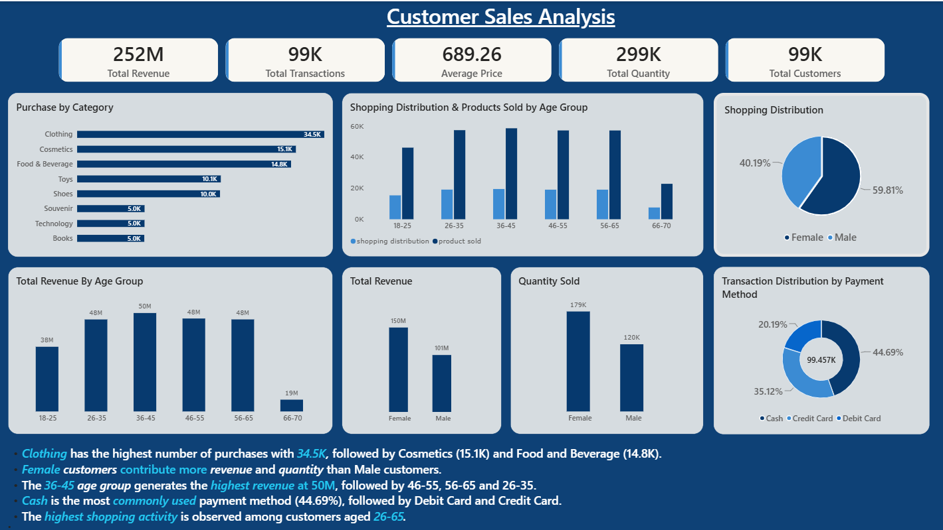
Customer Sales Analysis Dashboard
Screenshots:

